Slide 1
Brucellosis
Alessandro Gerada

Slide 2
Brief history of brucellosis
Described in many historical texts, all the way back to Hippocrates in 450 BC:
”Protracted fevers accompanied by ‘tumours’ and joint aches” (Hippocrates, n.d.)
In 1751, Cleghorn describes intermittent tertian fevers in Minorca (Cleghorn 1749).
In 1859, Assistant Surgeon Jeffrey Allen Marston described his own symptoms of “Mediterranean remittent” fever:
There is no fever so irregular as this in its course and symptoms

Slide 3
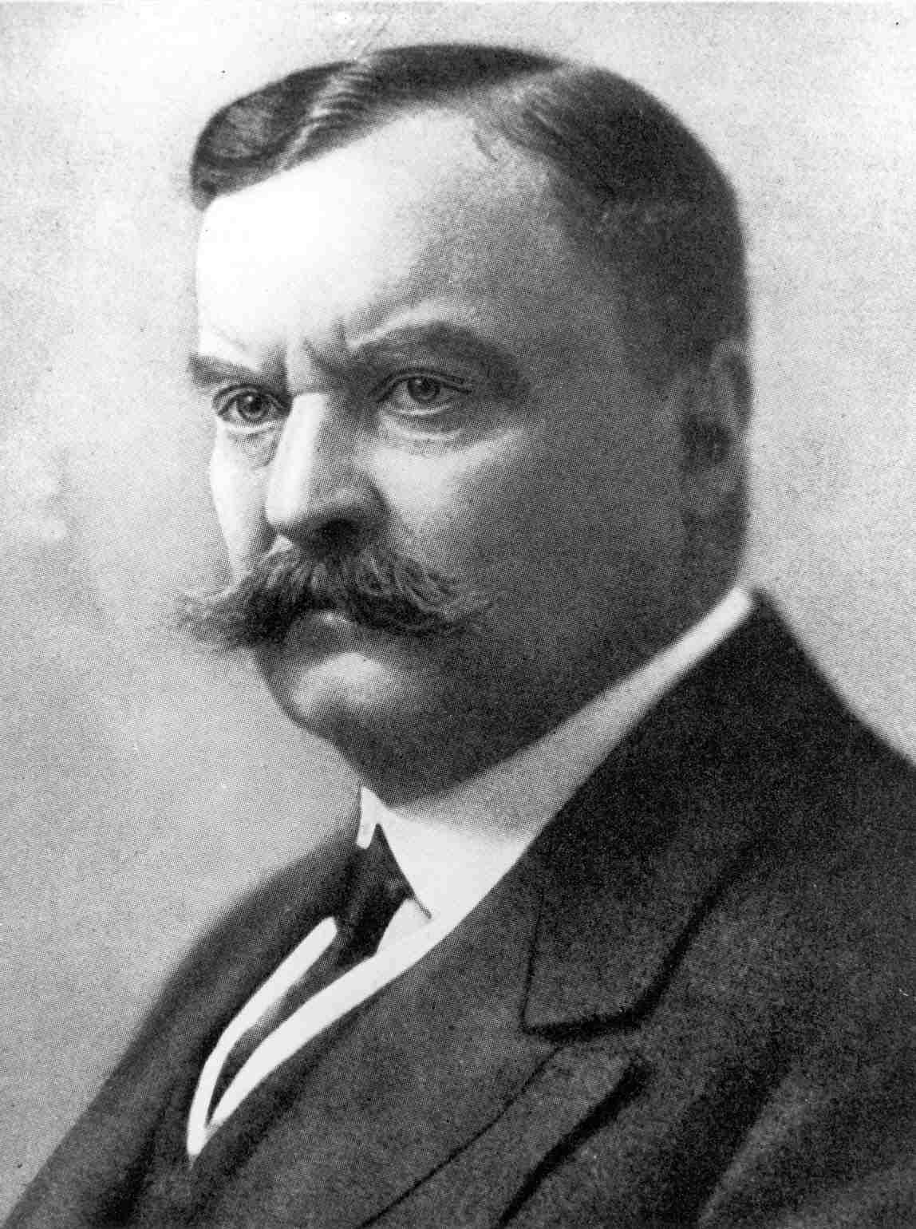
Sir David Bruce, in 1886, visualised and isolated Micrococcus melitensis from the spleen of a post-mortem patient:
“As it had been found by experiment that the air of the mortuary was peculiarly rich in germs … I removed the spleen to a small room in my quarters, the door and window of which had been keep shut for some time” (Bruce 1887)

Slide 4
Etymology
Malta fever
Rock fever
Undulant fever
Mediterranean fever
Gibraltar fever
Cyprus fever
Neapolitan fever
Italian fever
Crimean fever
Corps disease
Satan’s fever
Scottish delight
Bang’s disease
Goat fever
Fist of mercy
Milk sickness
Jones disease

Slide 5
Other important historical milestones
Development of serum agglutination method by Wright in 1897
Isolation of M. melitensis from goats by Temi Zammit in 1905

Slide 6
Against all odds
Zammit’s first attempt at investigated serostatus of 7 goats (H. V. Wyatt 2005):
all 7 were negative
it is estimated that at the time, 50% of Maltese goats were positive
odds of 7 negatives = 1:128
Repeated experiment in 1905 on 6 goats – 5 positive
Importantly, infected goats remained healthy

Slide 7
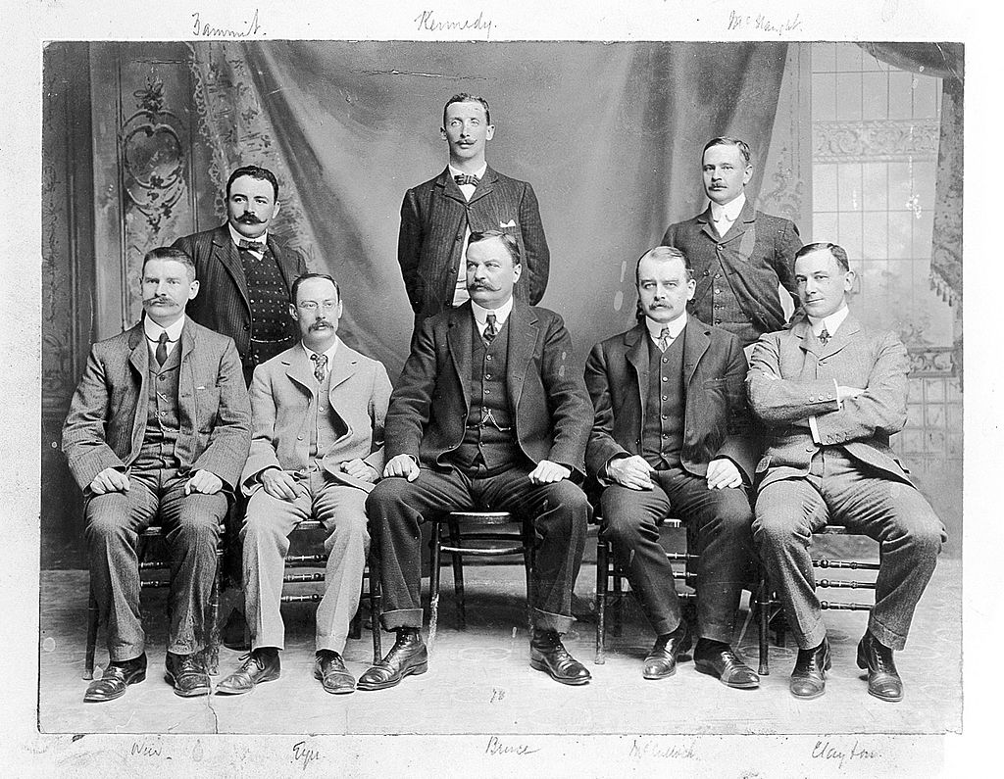
Mediterranean fever commission
(The Members of the Mediterranean Fever Commission. n.d.)

Slide 8
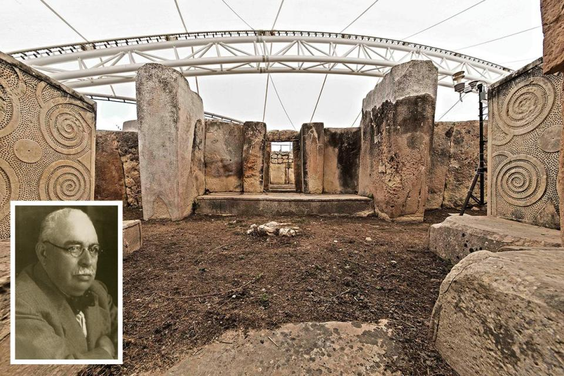
Sir Temi Zammit led the excavation of Tarxien temples (image c/o Heritage Malta)

Slide 9
Public health measures
Pasteurisation was not introduced until the late 1930
Public health measure to ban goat milk was put in place in 1906 (replaced with imported canned milk).
A milkman strike in protest of the measures likely contributed to disease control (Vassallo 1992).

Slide 10
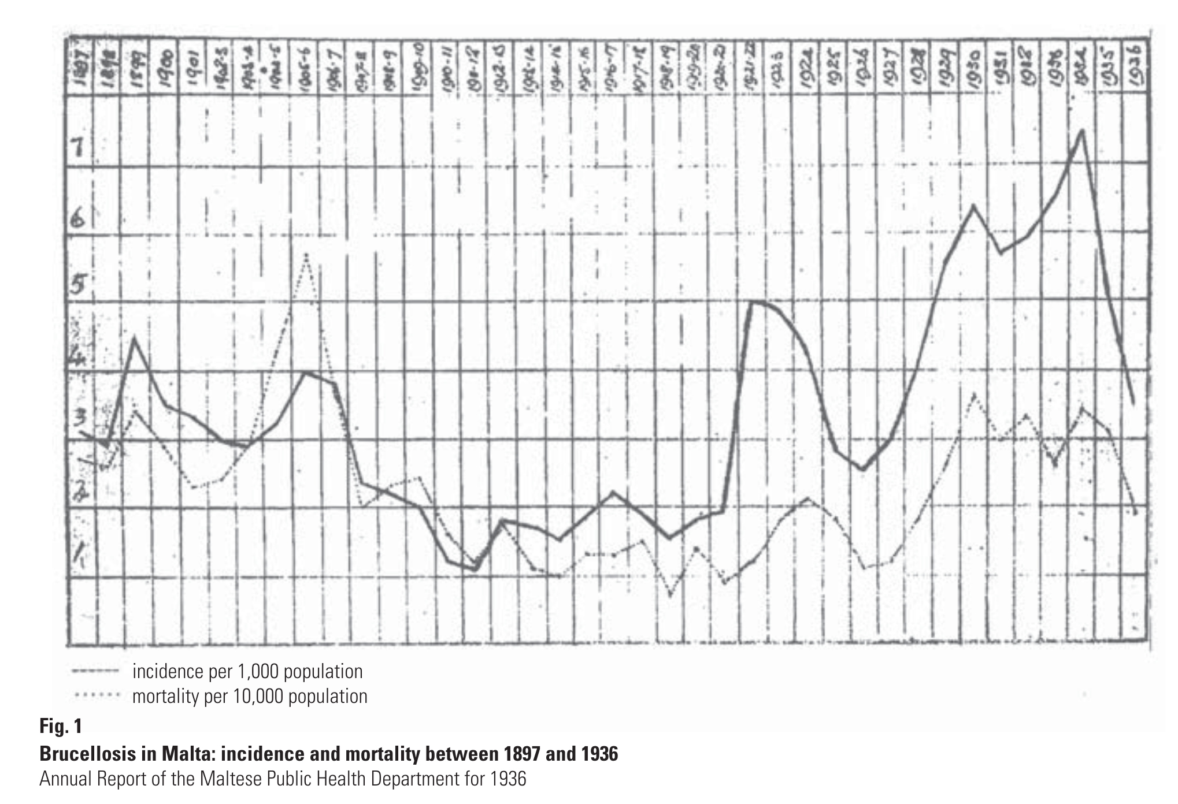
(H. P. Wyatt 2013)

Slide 11
Bruce and the microbe
David found a little Germ
Its name, of course, you know;
For everywhere that David goes
That name is sure to go.
He found it in a Spleen one day,
And raised a cultured stock;
“With you,” he said “I’ll demonstrate
The postulates of Koch.. ”
David knew a little Boat
That was for New York bound,
With five-and-sixty little goats
That yielded milk all round.
And in the milk that microbe lurked.
(Hence David would forbid it),
And when the men got sick and ill,
“Twas germs,” he said, “that did it.”
(Vassallo 1992)

Slide 12
Bacteriology of Brucella spp
Gram negative coccobacillus
Evolved from environmental soil organisms
“Triple positive”:
Oxidase positive
Catalase positive
Nitrate positive

Slide 13
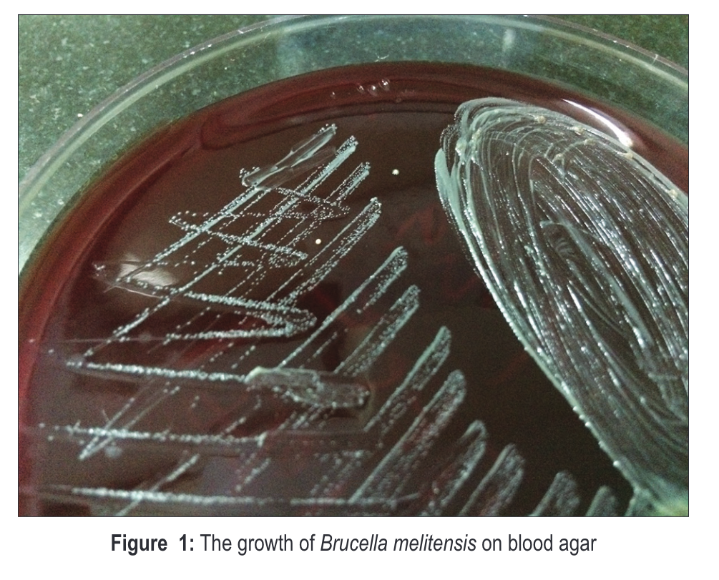
Brucella colonies
(Anantha et al. 2019)

Slide 14
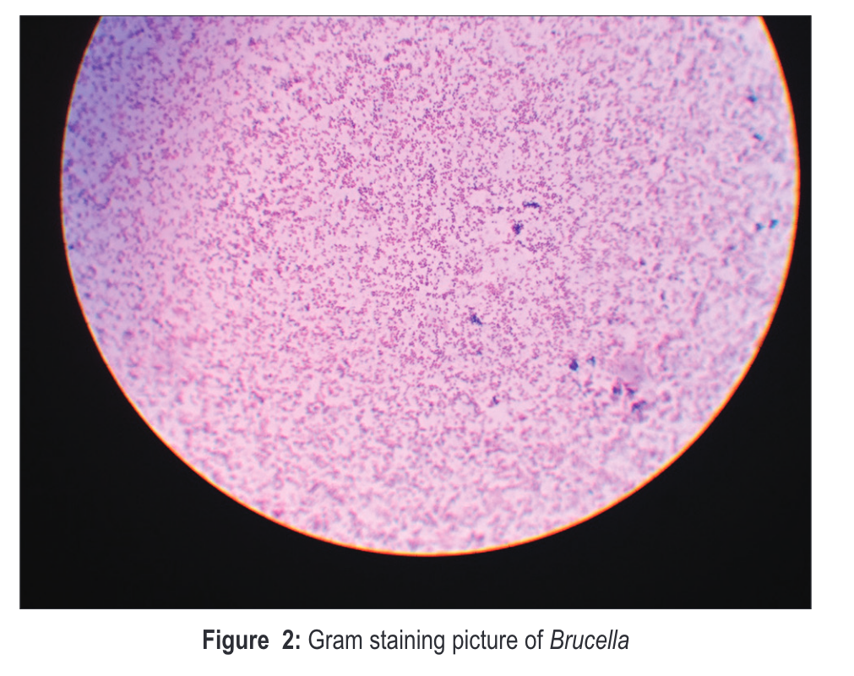
Brucella Gram stain
(Anantha et al. 2019)

Slide 15
Pathogenesis and immunity
Intracellular survival protects organism:
therapeutics depend on antimicrobials with high intracellular concentrations
long-term survival causes recurrence and treatment failure
Incomplete immunity

Slide 16
Species
Species | Preferred zoonotic host
B. melitensis | goats, camels
B. abortus | cattle
B. suis | pigs
B. canis | dogs
B. ovis | sheep
B. pinnipedialis | sea mammals
In 2020, the Ochrobactrum genus was controversially assigned to the Brucella genus (Moreno et al. 2022)

Slide 17
Transmission and risk factors
Modality | Mechanism
inhalation | aerosols
ingestion | dairy products
direct contact | inoculation/hypersensitivity
uncommon | human breast milk sexual blood transfusion bone marrow transplant

Slide 18
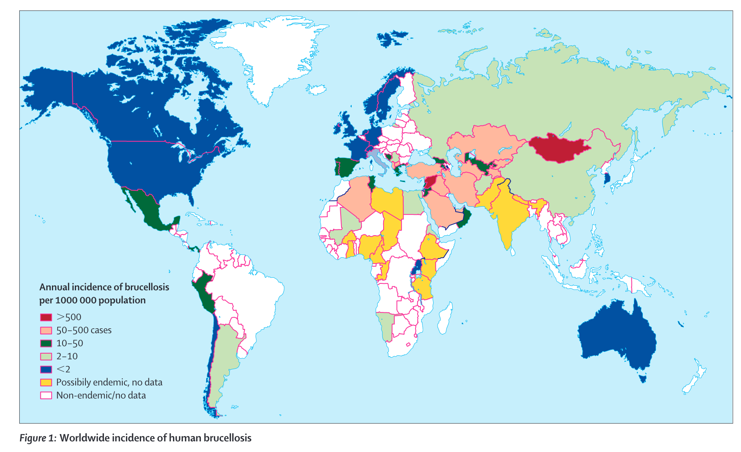
Worldwide epidemiology
(Pappas et al. 2006)

Slide 19
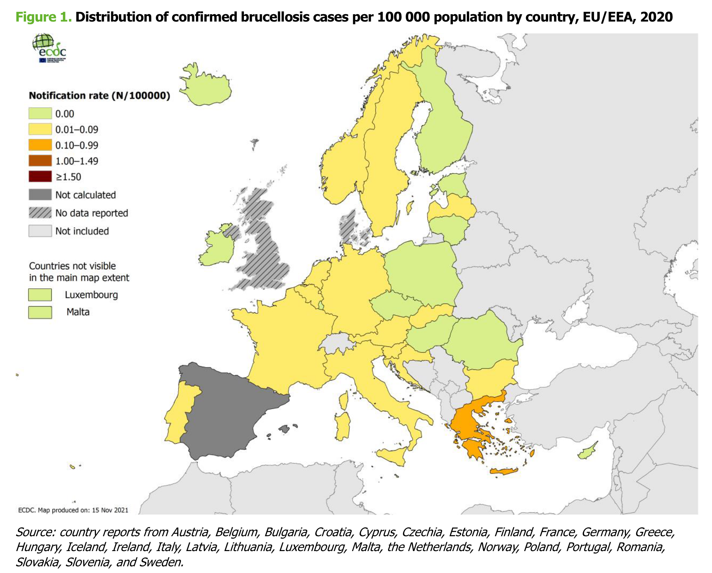
European epidemiology
(European Centre for Disease Prevention and Control 2022)

Slide 20
Clinical features of brucellosis in humans
Travel history is undoubtedly the most important question
Fever is the most important finding – classically undulating (waves) or remittent (comes and goes), although rarely seen
Musculoskeletal symptoms – differentiate febrile myalgia from localised bone and joint involvement
History may be long
Most patients are not severely unwell (if so, suggests infective endocarditis)
Any organ can be involved

Slide 21
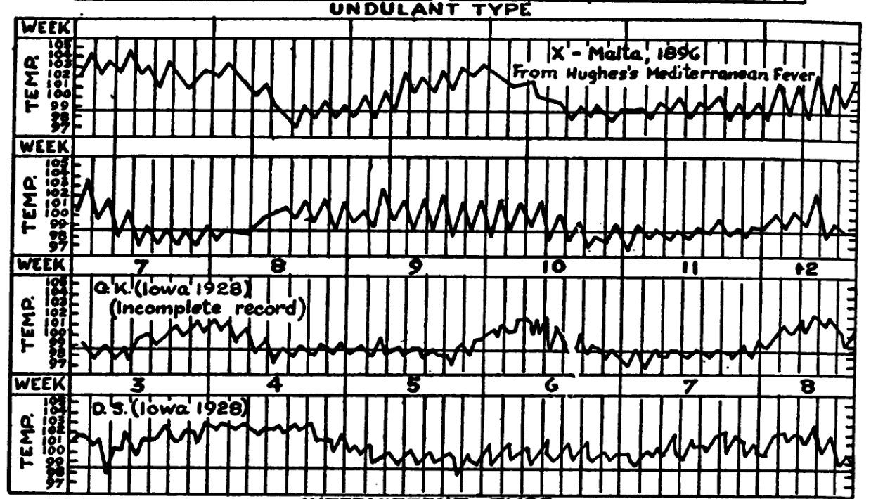
Undulant fever
(Hardy et al. 1930)

Slide 22
Diagnosis – culture
Culture is unequivocal evidence of infection (i.e., Brucellae do not colonise)
Blood culture:
sensitivity probably around 40-50%
requirement for extended incubation times is less important if using automated incubator
Bone marrow has higher sensitivity – 60%
Other sites – joints, abscesses, etc.
Identification – MALDI-TOF is good, but defaults to B. melitensis

Slide 23
Laboratory risk
Significant laboratory risk – probably the most important laboratory pathogen (Traxler et al. 2013)
Largest laboratory outbreak reported in Lanzhou, China (2019) (Pappas 2022)
An inadequacy in sanitizing processes in a biopharmaceutical plant in Lanzhou, China, during July and August 2019, led to the aerosolization of Brucella that was subsequently spread through wind to nearby settlements and academic institutes, resulting in more than 10 000 human brucellosis cases…
…officials responsible for the leak have been identified and punished…

Slide 24
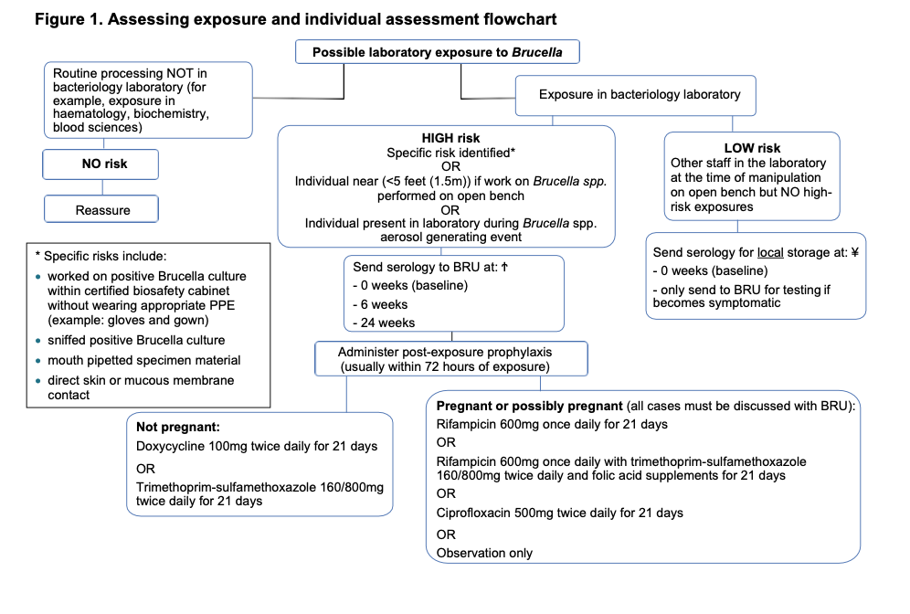
UK guidelines
Guidance on UK management available on BRU website (punishment for responsible microbiologists is not specified)

Slide 25
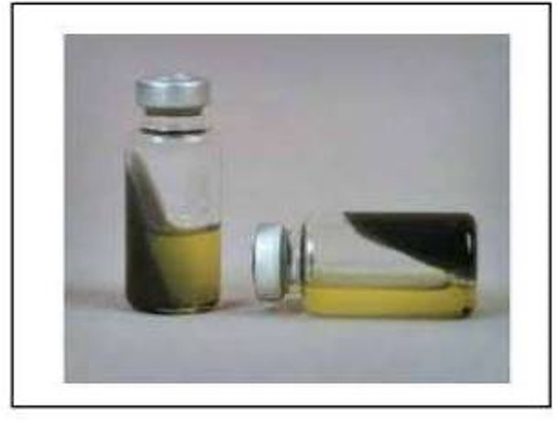
Castañeda medium
(Castaneda, n.d.)

Slide 26
Diagnosis – serology
Wright’s Serum Tube Agglutination remains the gold standard test – unchanged for over 120 years
Procedure:
Set up serial dilutions of the test serum
Add antigen (heated B. abortus) to tubes
Incubate overnight
Agglutinating serum forms clumps in the bottom of the tube
Non-agglutinating serum remains cloudy, with no clumps
B. canis lacks LPS, therefore needs specific serology

Slide 27
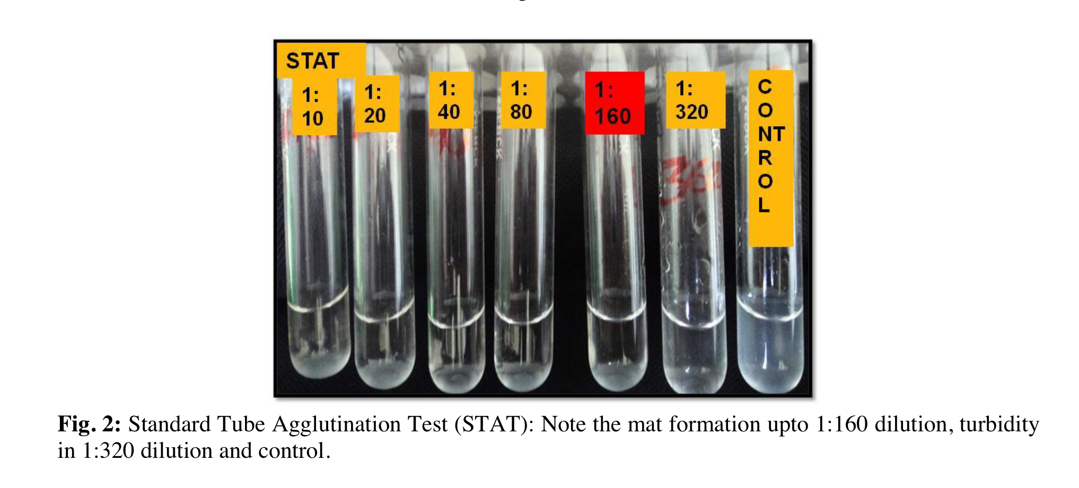
SAT
(Mariam et al. 2017)

Slide 28
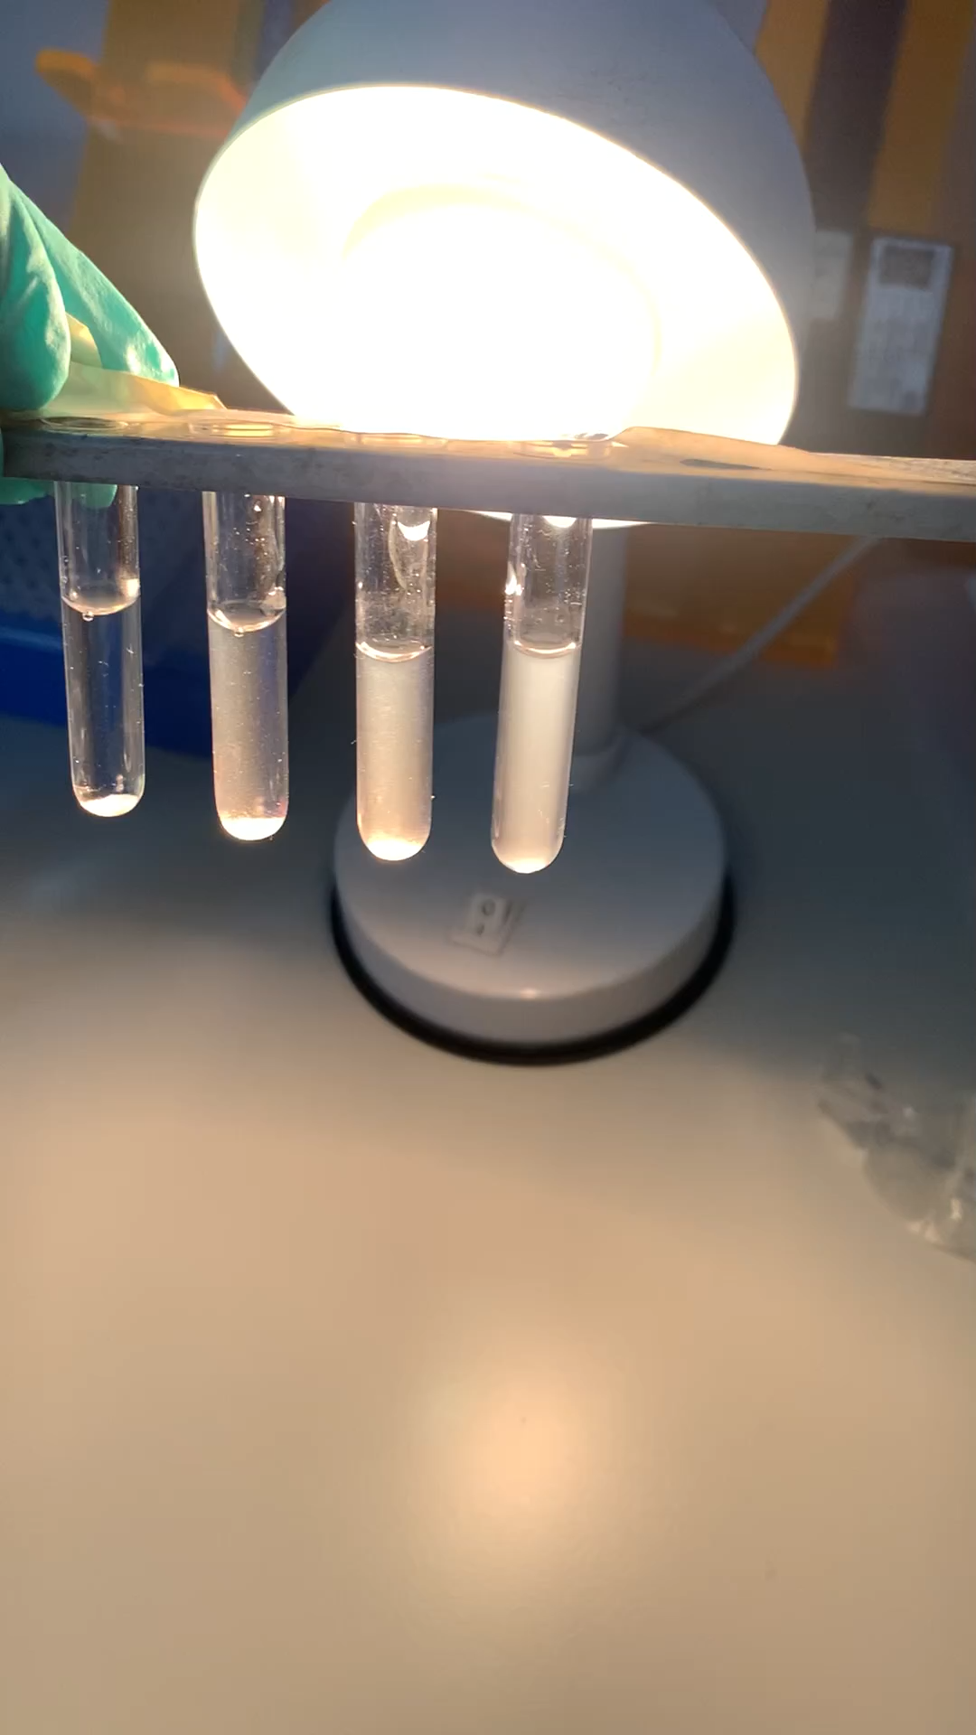
SAT for B. canis

Slide 29
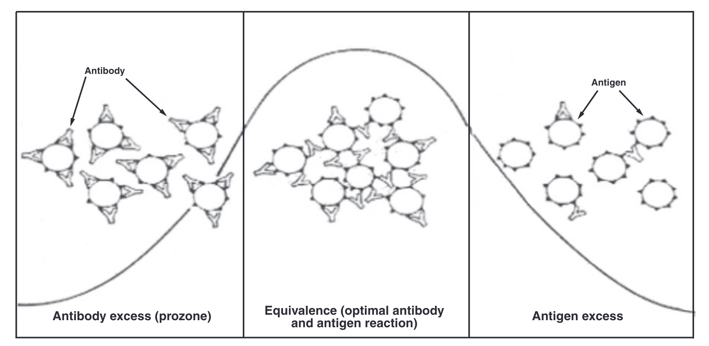
Prozone effect
(Jin and Zehnder 2016)

Slide 30
Interpretation of serology tests
Variation between runs and interpreter – quality assurance is critical
Ideally demonstrate 4-fold increase in titre
An absolute cut-off is hard to define – certain titres may be tolerated in endemic areas
1:160 is the most agreed on cut-off
Other agglutination tests, e.g., Rose Bengal, work the same way

Slide 31
Diagnosis – PCR
Around 80% sensitive
Useful, but beware of idiosyncratic prolonged positivity

Slide 32
Treatment
Susceptibility testing is not helpful, although note that B. abortus live vaccine strain is inherently rifampicin resistant
Two agents minimum
Duration:
Uncomplicated/acute – 6 weeks
Chronic/complicated – 12 weeks

Slide 33
Antimicrobial agents
In order of likely efficacy:
doxycycline & streptomycin (or gentamicin)
doxycycline & rifampicin
doxycycline & co-trimoxazole
Children (under 8) and pregnancy – rifampicin & co-trimoxazole

Slide 34
Global Impact
Brucellosis is likely to be the most common worldwide zoonotic disease
Although mortality rare, morbidity and loss of productivity due to illness is high
Brucella canis will continue to be of increasing concern in Europe and US
Lanzhou outbreak shows why Brucella spp continue to be recognised bioterrorism agents

Slide 35
Further reading
On laboratory acquired infection: Traxler, R.M., Lehman, M.W., Bosserman, E.A., Guerra, M.A., Smith, T.L., 2013. A literature review of laboratory-acquired brucellosis. J Clin Microbiol 51, 3055–3062. https://doi.org/10.1128/JCM.00135-13
On diagnostic methods: Yagupsky, P., Morata, P., Colmenero, J.D., 2019. Laboratory Diagnosis of Human Brucellosis. Clin Microbiol Rev 33, e00073-19. https://doi.org/10.1128/CMR.00073-19
On epidemiology and control: Corbel, M.J., Food and Agriculture Organization of the United Nations, World Health Organization, World Organisation for Animal Health, 2006. Brucellosis in humans and animals.
Others: Brucella Reference Unit website – flowcharts for laboratory exposure and request forms
CDC Brucella Reference Guide – useful general information

